Slide 1


Slide 2
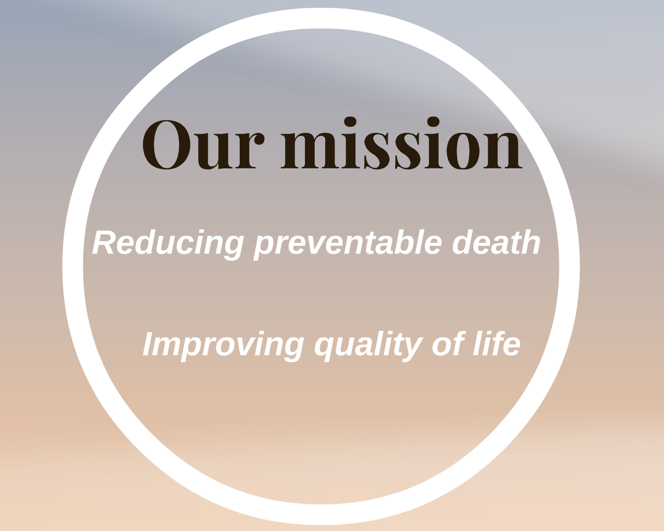
The point

Slide 3
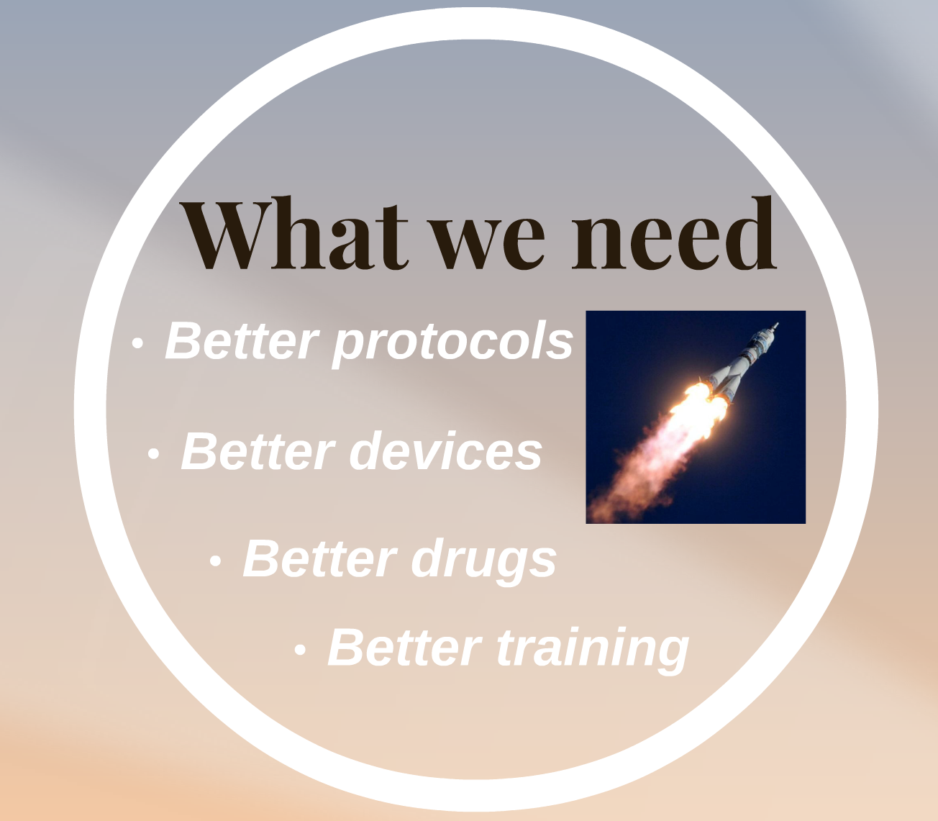
The point

Slide 4

What we need

Slide 5

What we need

Slide 6
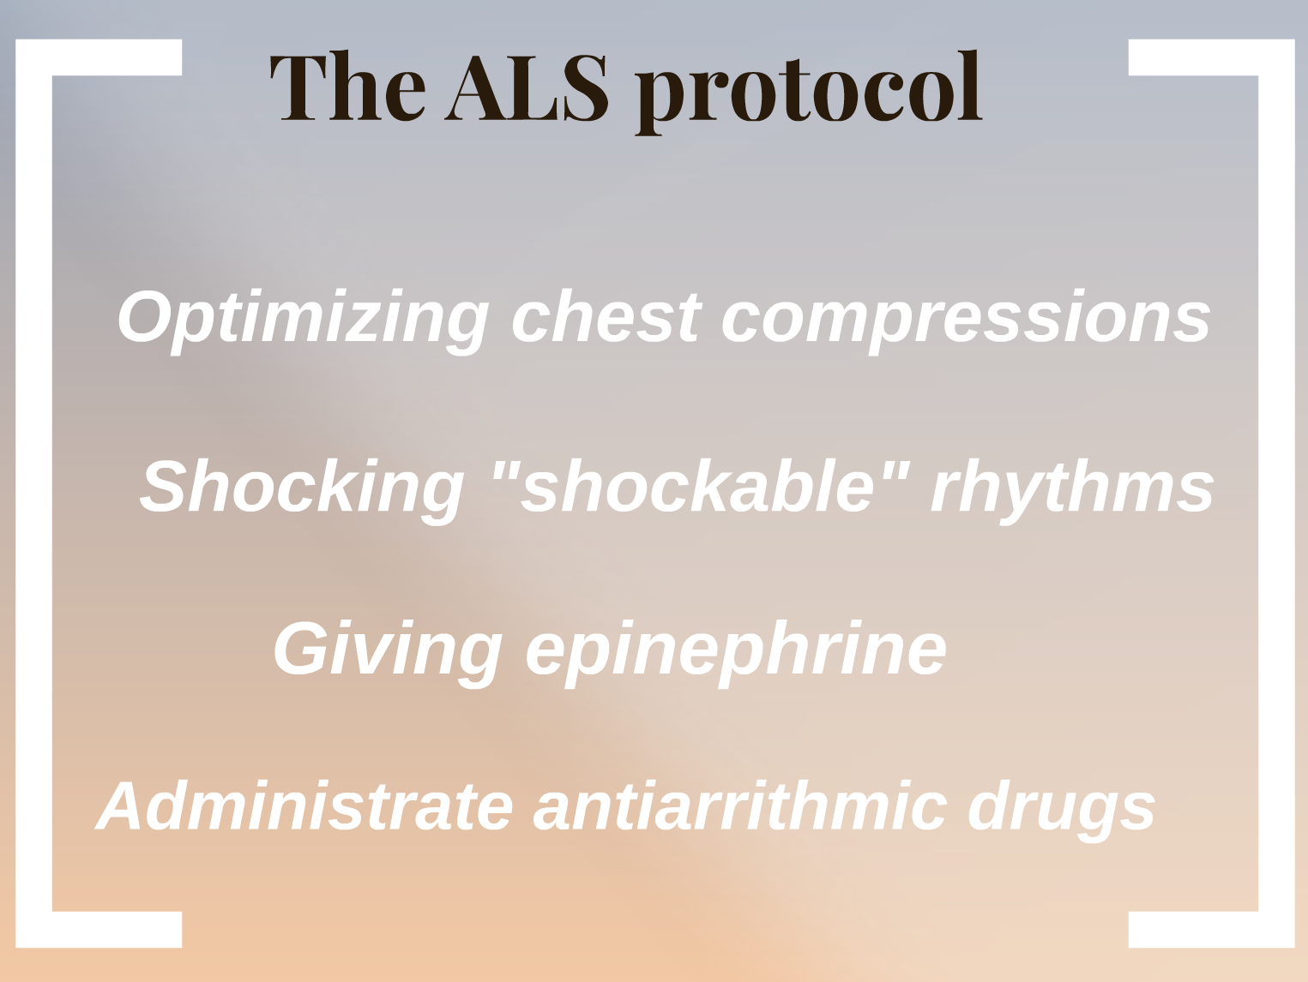
Medical cardiac arrest

Slide 7
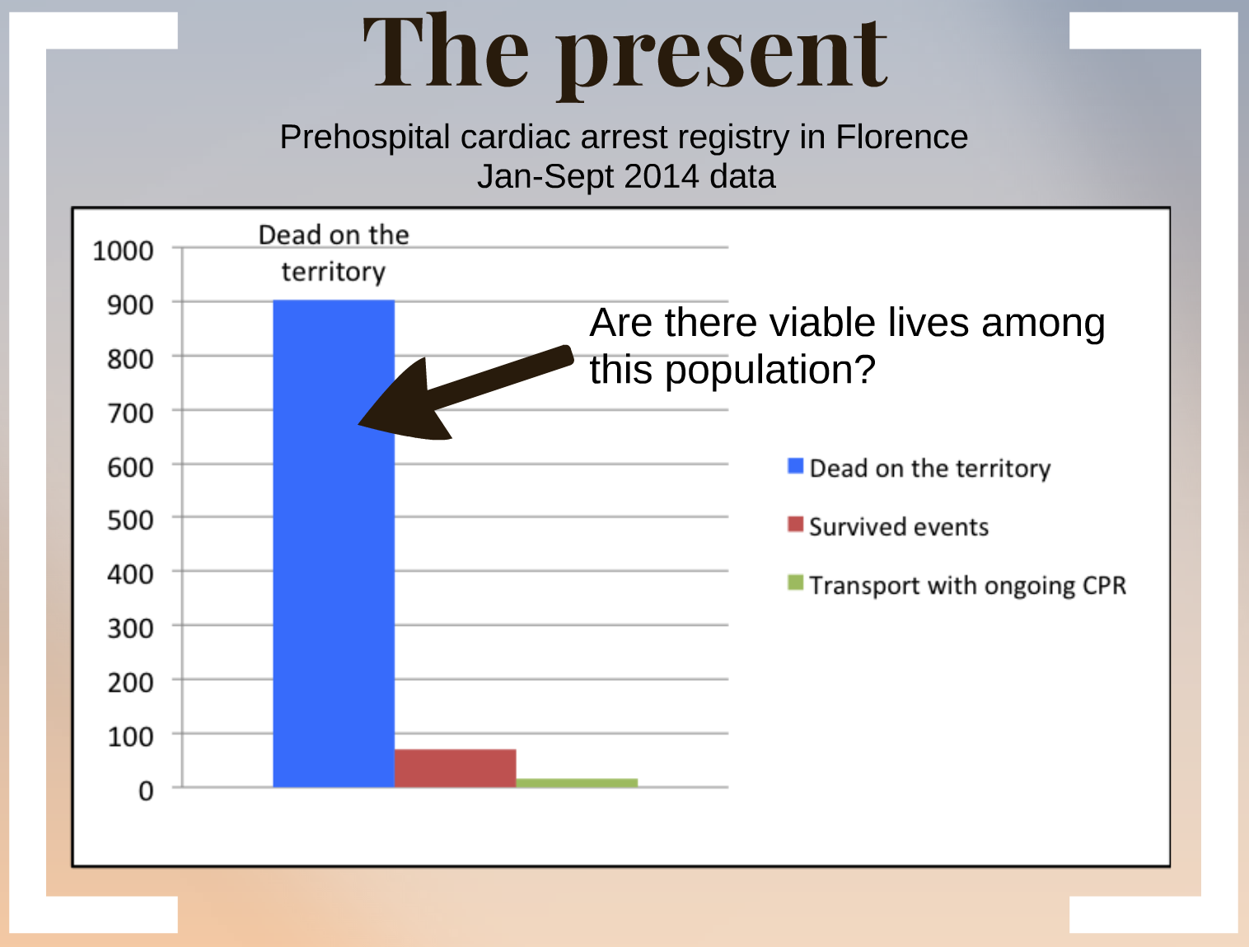
Medical cardiac arrest

Slide 8
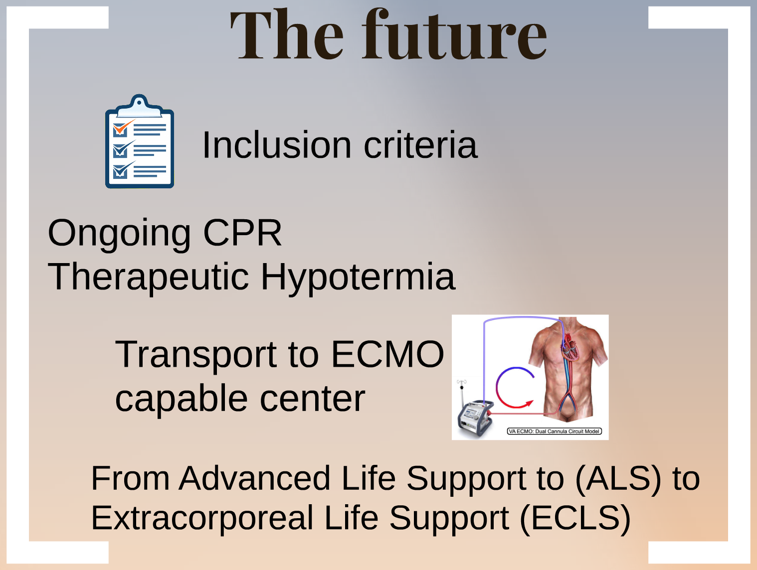
Medical cardiac arrest

Slide 9

What we need

Slide 10
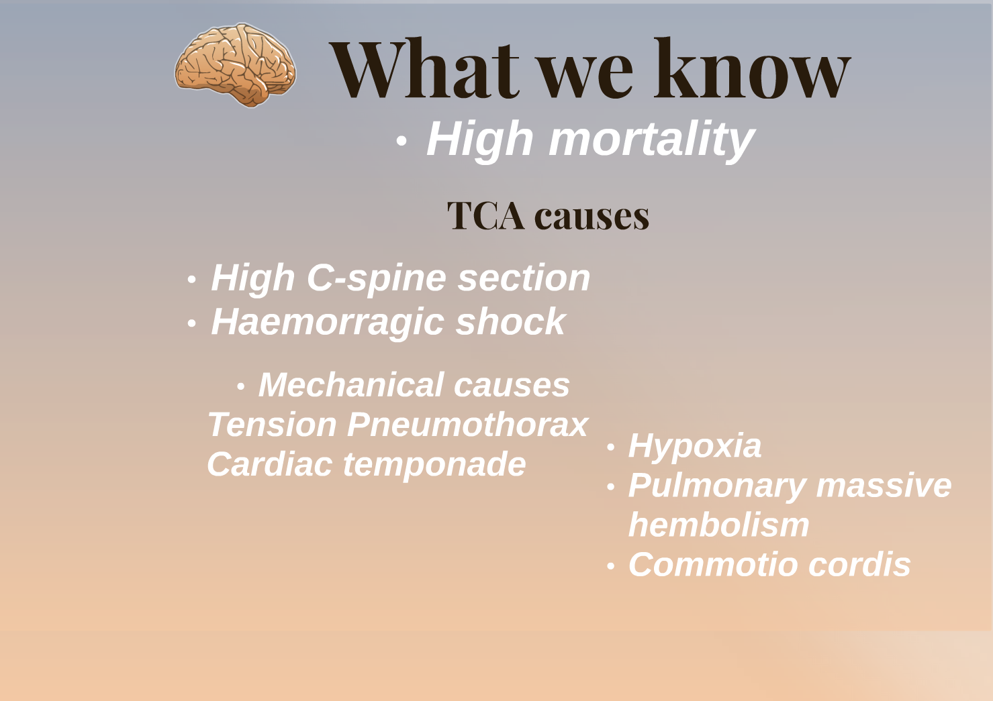
Traumatic cardiac arrest

Slide 11
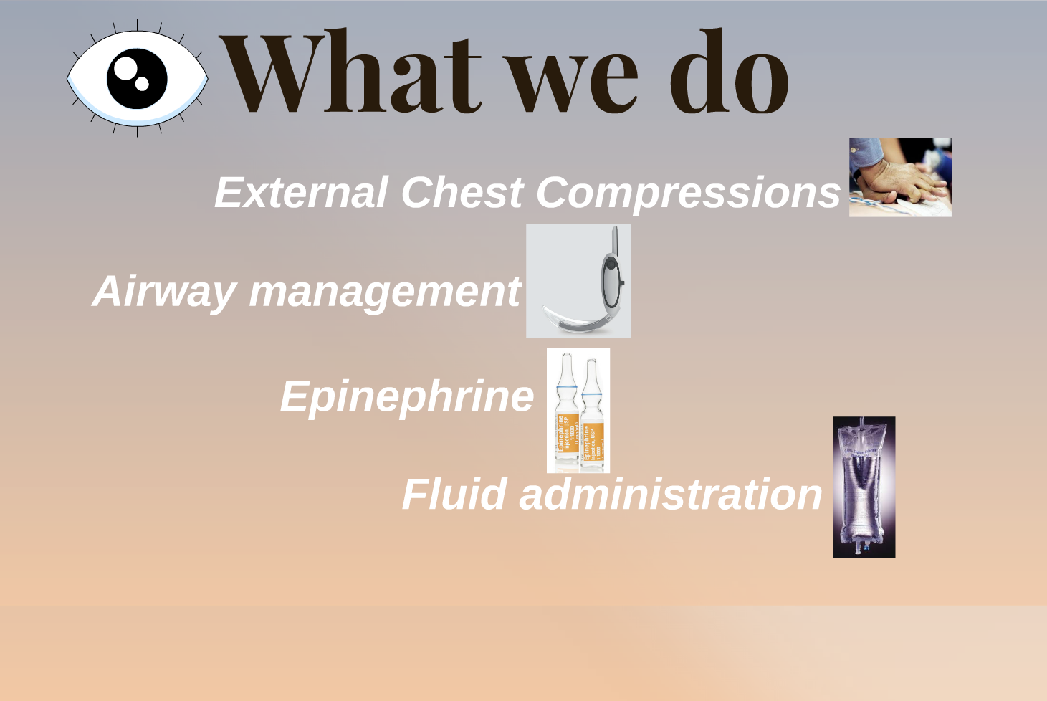
Traumatic cardiac arrest

Slide 12
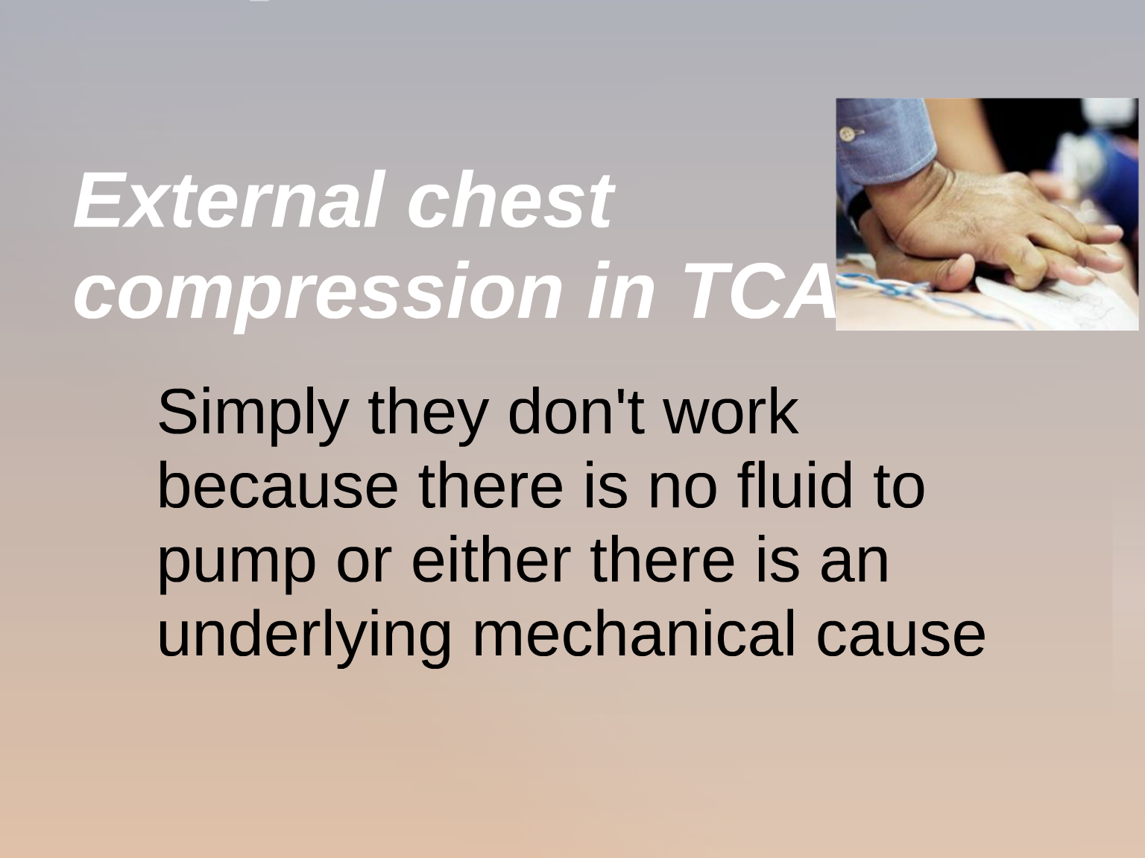
Traumatic cardiac arrest
Evidences

Slide 13
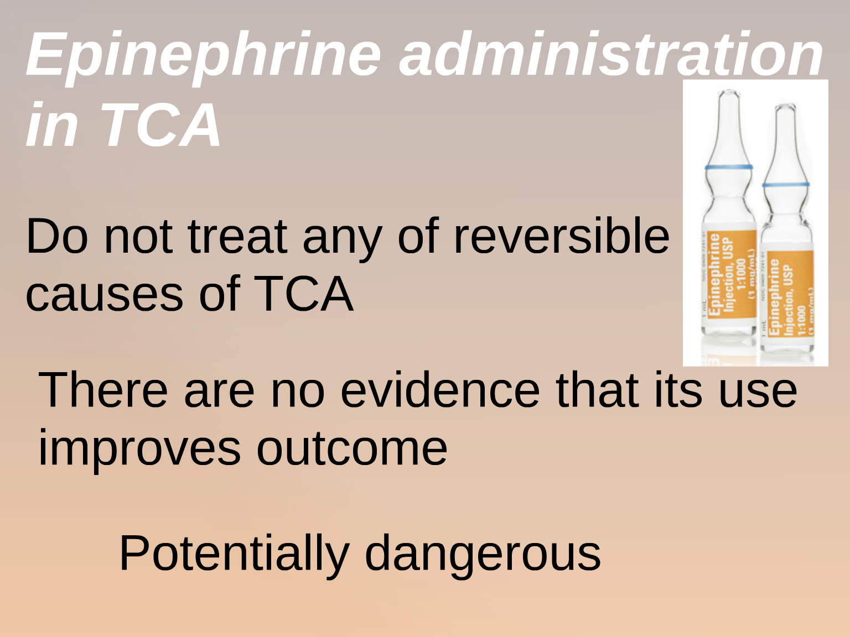
Traumatic cardiac arrest
Evidences

Slide 14
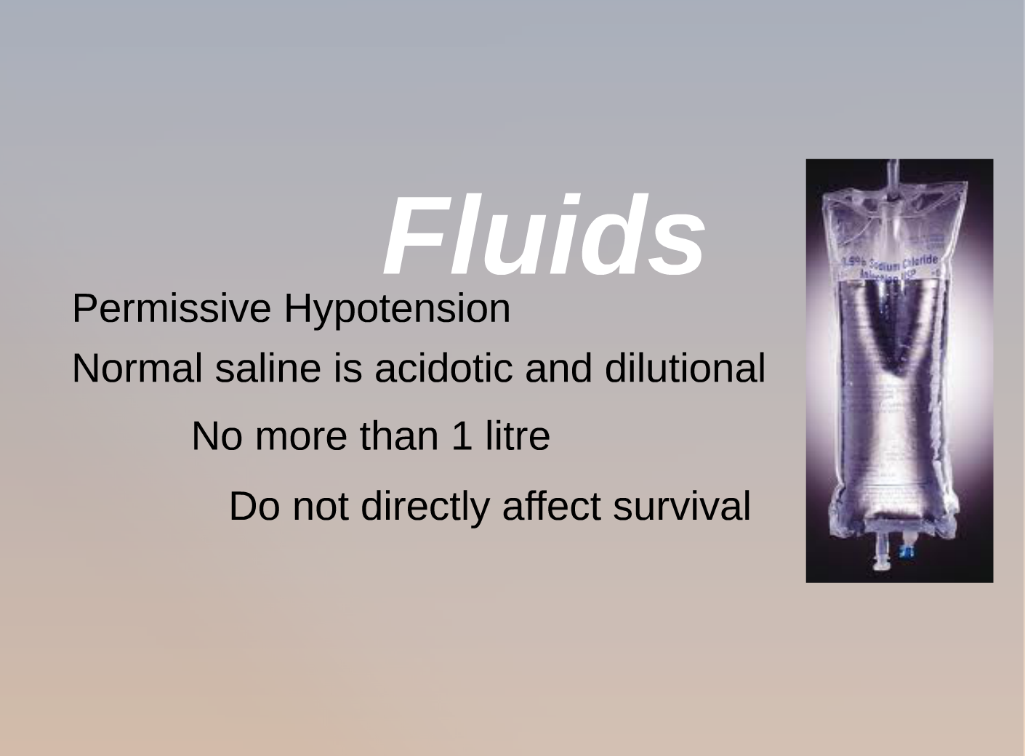
Traumatic cardiac arrest
Evidences

Slide 15
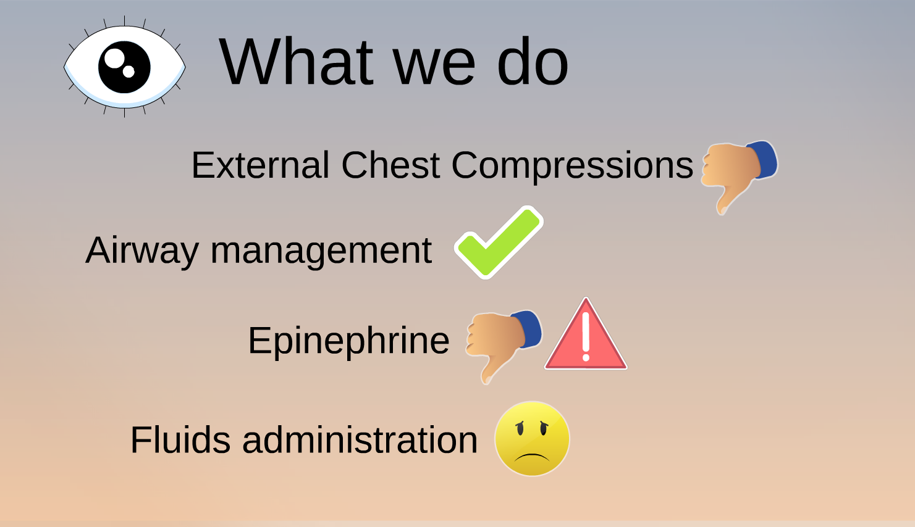
Traumatic cardiac arrest
Evidences

Slide 16
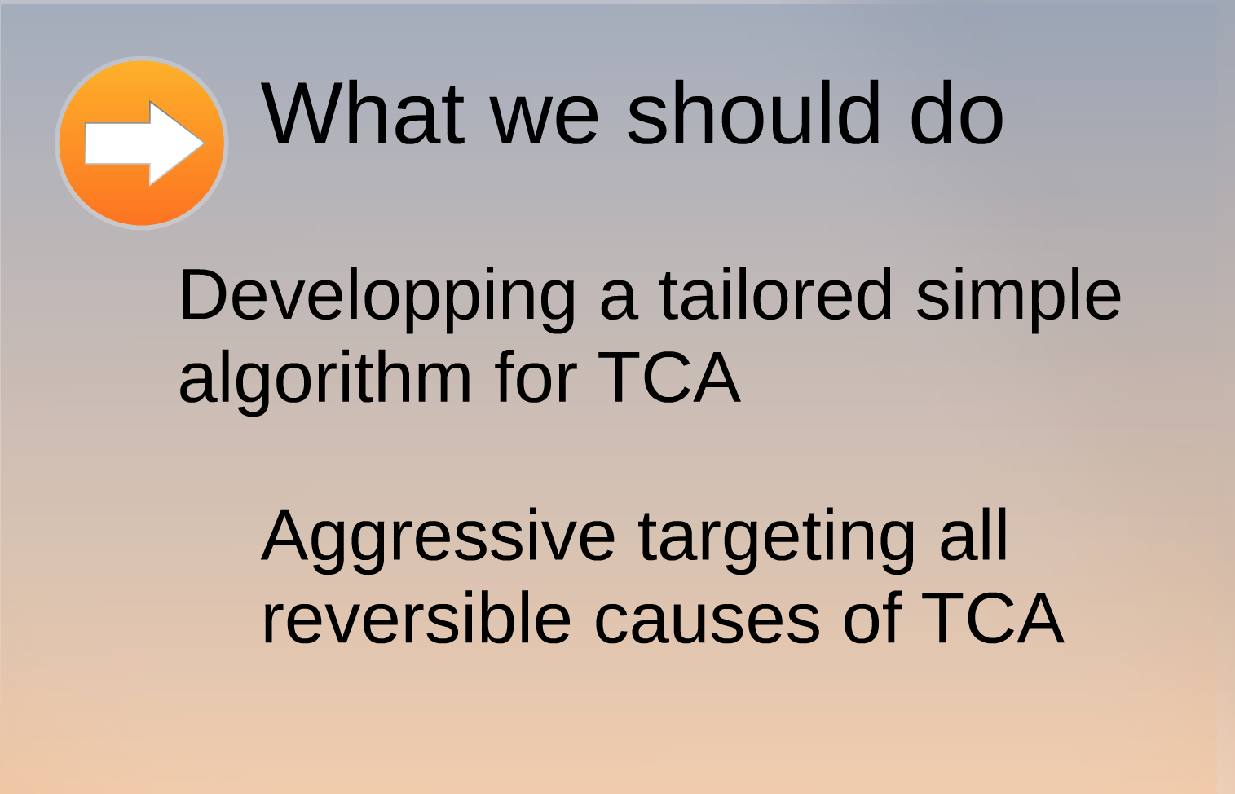
Traumatic cardiac arrest

Slide 17
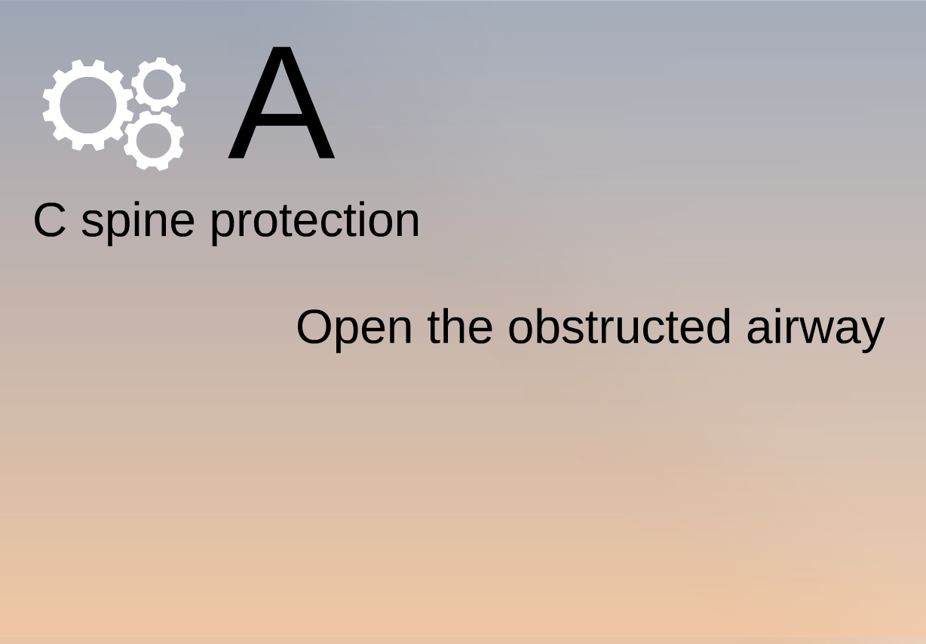
Traumatic cardiac arrest

Slide 18
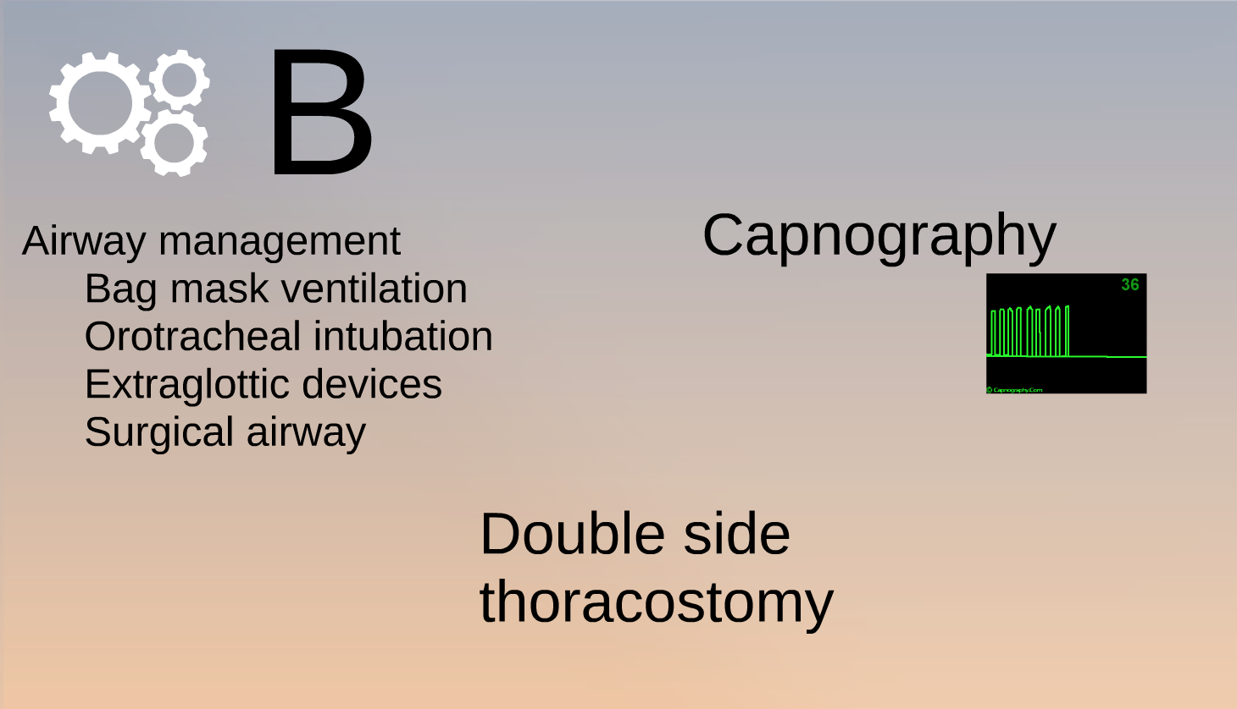
Traumatic cardiac arrest

Slide 19
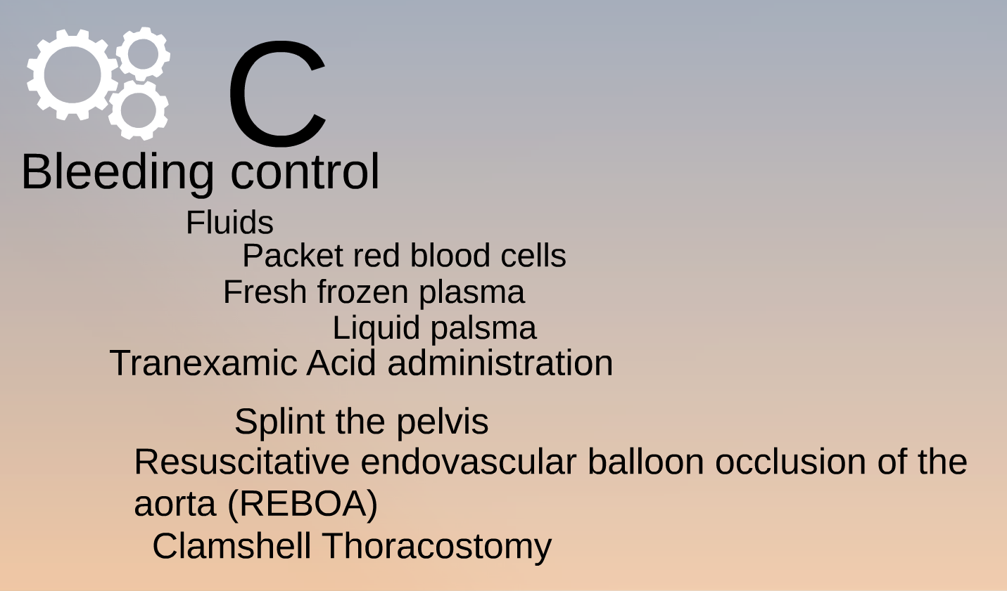
Traumatic cardiac arrest

Slide 20

What we need

Slide 21

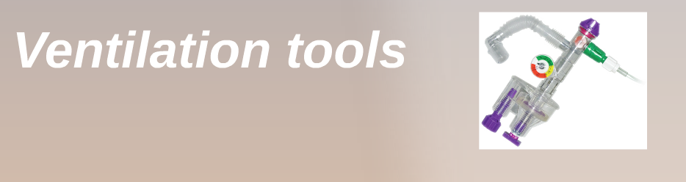
Better devices

Slide 22
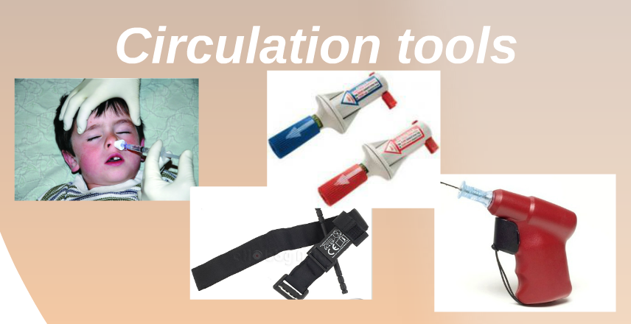
Better devices

Slide 23
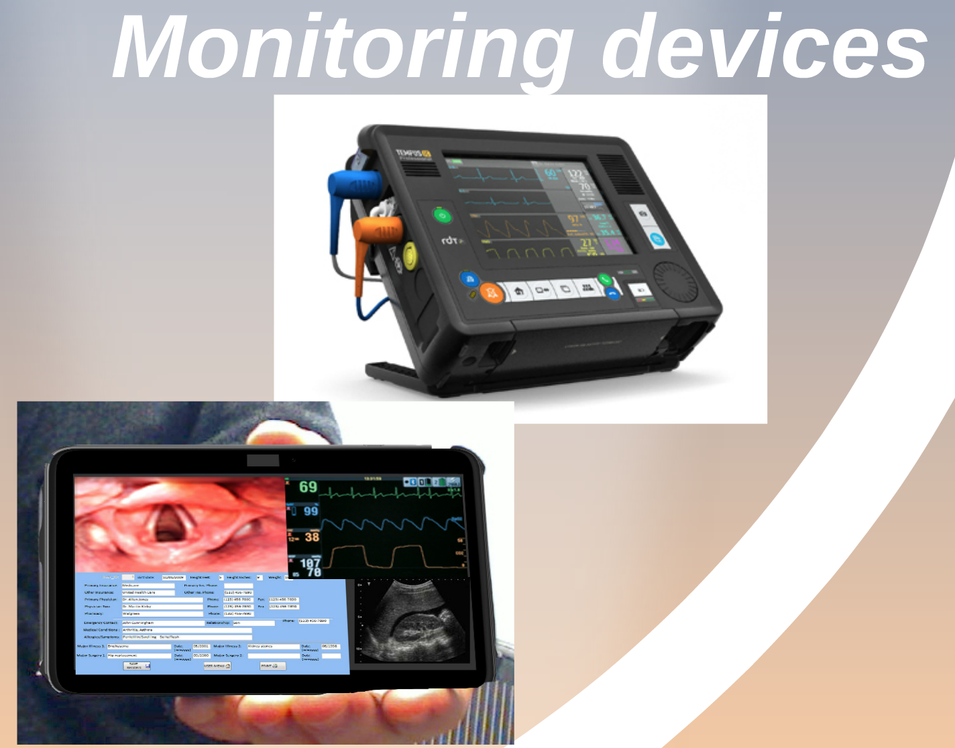
Better devices

Slide 24
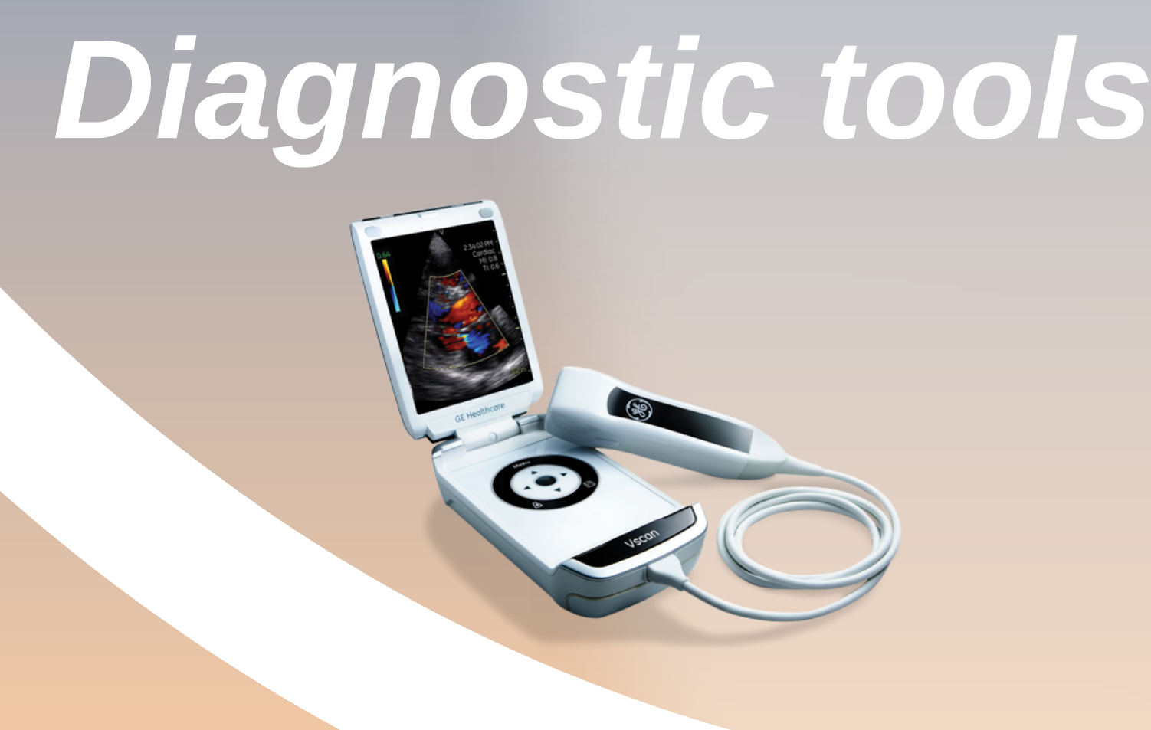
Better devices

Slide 25

What we need

Slide 26
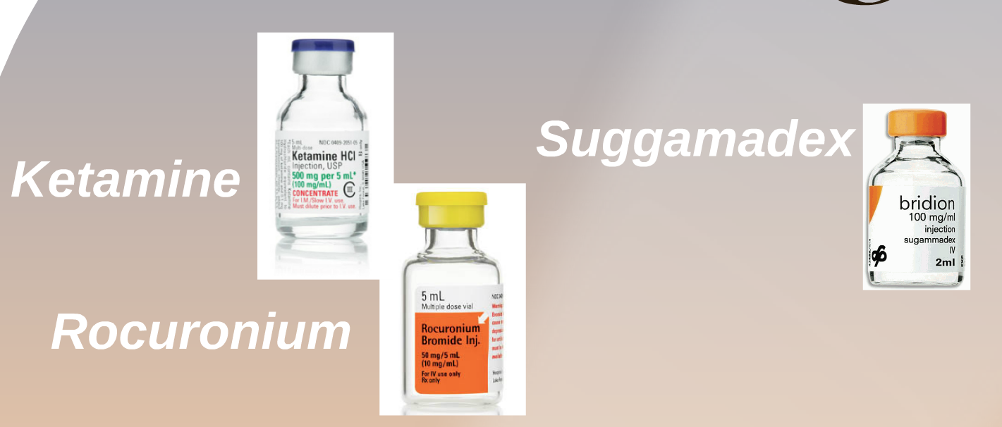
Better drugs

Slide 27
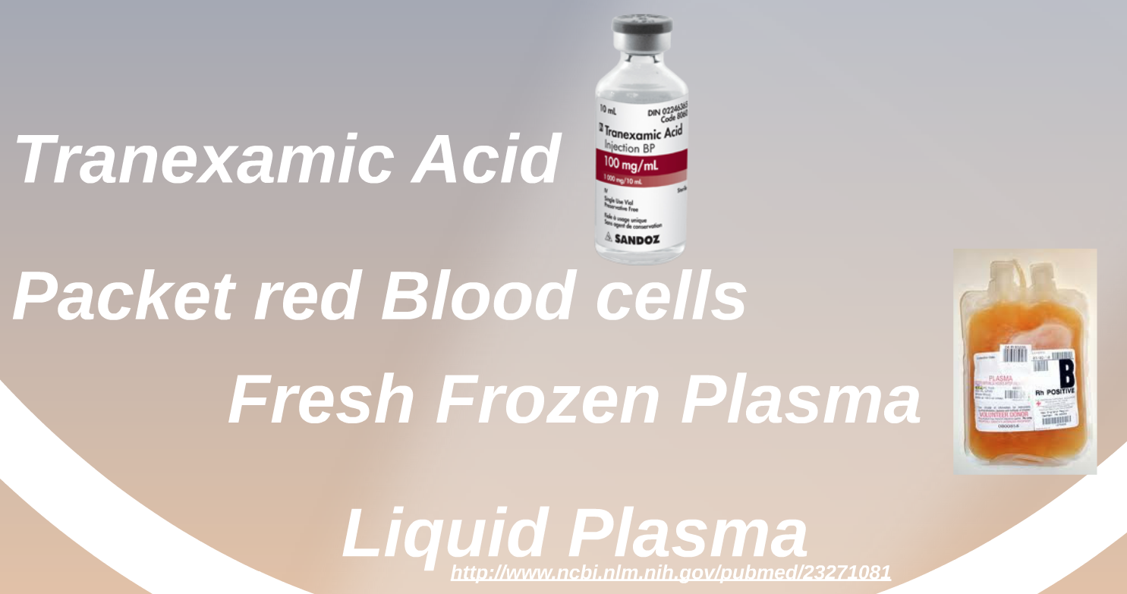
Better drugs

Slide 28

What we need

Slide 29
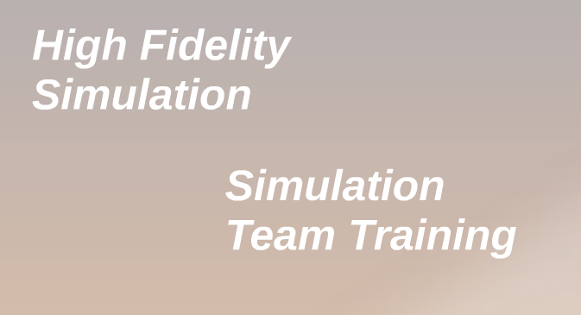
Better training

Slide 30

Better training

Slide 31


